Slide 1
VIRTUALIZATION TECHNIQUES

Slide 2
Cloud Deployment Models and Virtualization
Deployment models: Public cloud – Private Cloud –Hybrid cloud – Community cloud - Need for virtualization – Types of Virtualization – Virtualization OS – VMware, KVM – System VM – Process VM - Virtual Machine Monitor – Properties - Xen, Hyper V, Virtual Box, Eucalyptus

Slide 3
TEXT / REFERENCE BOOKS
William von Hagen, Professional Xen Virtualization, Wrox Publications, January, 2008.
Chris Wolf, Erick M. Halter, Virtualization: From the Desktop to the Enterprise, APress 2005
Kumar Reddy, Victor Moreno, Network virtualization, Cisco Press, July, 2006.
James E. Smith, Ravi Nair, Virtual Machines: Versatile Platforms for Systems and Processes, Elsevier/Morgan Kaufmann, 2005.
David Marshall, Wade A. Reynolds, Advanced Server Virtualization: VMware and Microsoft Platform in the Virtual Data Center, Auerbach Publications, 2006.

Slide 4
Virtualization in Cloud Computing
Virtualization is the "creation of a virtual (rather than actual) version of something, such as a server, a desktop, a storage device, an operating system or network resources"..
In other words, Virtualization is a technique, which allows to share a single physical instance of a resource or an application among multiple customers and organizations.

Slide 5
What Is Virtualization?
Virtualization is simply the logical separation of the request for some service from the physical resources that actually provide that service.
In practical terms, virtualization provides the ability to run applications, operating systems, or system services in a logically distinct system environment that is independent of a specific physical computer system.
. Virtualization’s focus on logical operating environments rather than physical ones makes applications, services, and instances of an operating system portable across different physical computer systems.

Slide 6
Example of virtualization
People are already familiar with is virtual memory, which enables a computer system to appear to have more memory than is physically installed on that system.
Virtual memory is a memory-management technique that enables an operating system to see and use noncontiguous segments of memory as a single, contiguous memory space. Virtual memory is traditionally implemented in an operating system by paging,

Slide 7
virtualization
Modern operating systems such as UNIX-like operating systems (including Linux, the *BSD operating systems, and Mac OS X) and Microsoft Windows all use some form of virtual memory to enable the operating system and applications to access more data than would fit into physical memory.
there are many different types of virtualization, all rooted around the core idea of providing logical access to physical resources. Today, virtualization is commonly encountered in networking, storage systems, and server processes, at the operating system level and at the machine level.
. Xen, the subject of this book, supports machine-level virtualization using a variety of clever and powerful techniques

Slide 8
Server Consolidation
Definition - Server consolidation refers to thServer Consolidation e use of a physical server to accommodate one or more server applications or user instances. Server consolidation makes it possible to share a server’s compute resources among multiple applications and services simultaneously. It is mainly used to reduce the number of servers required in an organization.

Slide 9
The Basics of Virtualization
A great example of how virtualization works in your daily life is the separation of your hard drive into different parts.
While you may have only one hard drive, your system sees it as two, three or more different and separate segments.
Similarly, this technology has been used for a long time.

Slide 10
Virtual Machine Monitor
A Virtual Machine Monitor (VMM) is a software program
That enables the creation, management and governance of virtual machines (VM) and manages the operation of a virtualized environment on top of a physical host machine. VMM is also known as Virtual Machine Manager

Slide 11
Virtual Machine
Virtual Machine is defined as software of a computer which provides the functionality similar to the physical computers
They run operating system and applications on top of it but they differ from the physical computer
The fact that they are computer files, known as an image which runs on top of physical computers using the hypervisor.
Due to this the user has the liberty of running multiple operating systems on top of the main operating system without the need of buying additional physical resource.

Slide 12
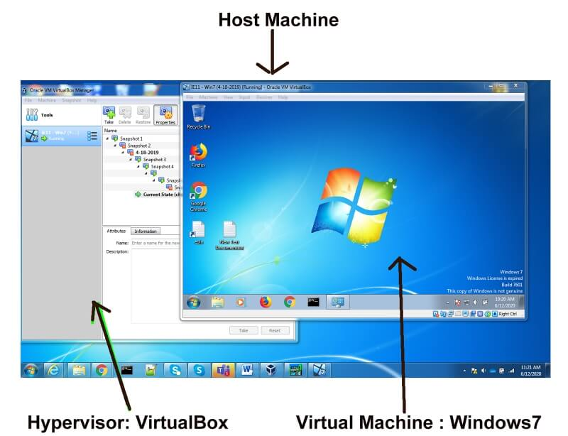
Virtual Machine

Slide 13
Virtual Machine
This means that a computer is created inside a computer. It works in a window, like any program, providing the end-user with the same virtual system
Many virtual machines can run on the same physical computer simultaneously. For servers, several operating systems run side-by-side with the software known to be managed as a hypervisor,
. A hypervisor, also known as a virtual machine monitor or VMM, is software that creates and runs virtual machines (VMs). A hypervisor allows one host computer to support multiple guest VMs by virtually sharing its resources, such as memory and processing.

Slide 14
Virtual Machine
whereas desktop computers normally run other operating systems in their program windows by using one operating system.Experience on the host operating system.
A hypervisor, sometimes called a virtual machine monitor (VMM),

Slide 15
Virtual Machine Advantages

Slide 16
Cost-Effective Software
VMware software is an affordable software that most large scale business can easily afford. Cost-effective does not mean that anyone can afford it but used as other parts that help in business growth.
It improves your business virtualization at affordable rates that have an outstanding track record. So, if you are looking for any type of software for cloud computing then you must give VMware a try.

Slide 17
Entire Test Environment is Low Budget
While testing multiple applications in multiple environments can cost you very high.
But the availability of VMware made things easy and low budget. With the existing function of multiple handling environments.
you can do the entire software test at a reasonable price.

Slide 18
Fast Rollback Feature
VMware software is totally an environment based software for testing and cloud computing.
At the time of adding or creating a new virtual machine, if you face any type of error then you can easily rollback all the things like before.
Using fast rollback features is very beneficial if you suddenly faced a major or minor error and want to end the process.

Slide 19
Adding New Virtual Machine is Easy
One of the best features or advantages of VMware, you can easily add a new virtual machine in plenty of time.
Even the newcomers with basic knowledge can implement a virtual machine which is quite impressive.
Anyone can create an OS (Operating System) or environment with a few simple steps.

Slide 20
Multiple OS Allowed
VMware allows a user to install or create multiple virtual machines so they can relatively works on it.
Not only create but also you can easily access them at the same time which is totally impressive.
For example, you can create a virtual machine with the environment Linux based. After that, you can add some more operating systems like Windows 7, XP, 10, and some others at the same time.
And by launching all these virtual machines at the same time you can easily teleport yourself from one environment to another one.

Slide 21
Easy to Delete Virtual Machine
Just like adding virtual machine features of VMware, you can also delete the entire or specific virtual machine as per need.
It takes a few minutes to perform that task and clean the storage of your device.
After deleting the virtual memory, you have the storage space, in which you can create another virtual machine. Fulfilling such user requirements is one of the advantages of VMware.

Slide 22
Wide Number of Users
Many users make use of VMware for different purposes.
Some users use it for testing software or program in different environments. On the other hand, some users use VMware as a virtual machine and perform ethical hacking practices over it.

Slide 23
Virtual Machine Disadvantages

Slide 24
Low Performance
VMware software is designed to work on high-class devices. So, as per this condition, if your business doesn’t have the best system then you will get low performance.
The same rule applies to personal users too who use VMware for multipurpose use. VMware helps to create a different OS environment that runs on your system resources.

Slide 25
Lack of Reliability
The physical devices play an important role.
Because of this problem lack of reliability occurs. You can’t measure how reliable VMware software can be which is quite depressing.
If your device is not super fast then you will face a lot of problems for sure.

Slide 26
Need Handling Skills
Using VMware is not just too easy for anyone who does not have any technical background.
Also, there’s a chance you probably corrupt your storage device, which is the worst case. So, either you read the basics from the official site or online tutorial after that use the VMware.

Slide 27
Not Best For Complete Physical Product Testing
VMware is designed to test the software or program in a different environment.
But this advanced technology is not best for that software that relies on complete physical testing.
For example, if you are testing a program’s functionalities like Storage, Speed, Reliability and more then you won’t get accurate results at all.
Because reliability and speed are totally depending on your physical testing rather than the environment.

Slide 28
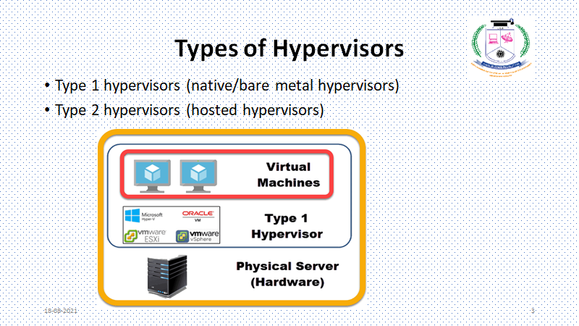

Slide 29
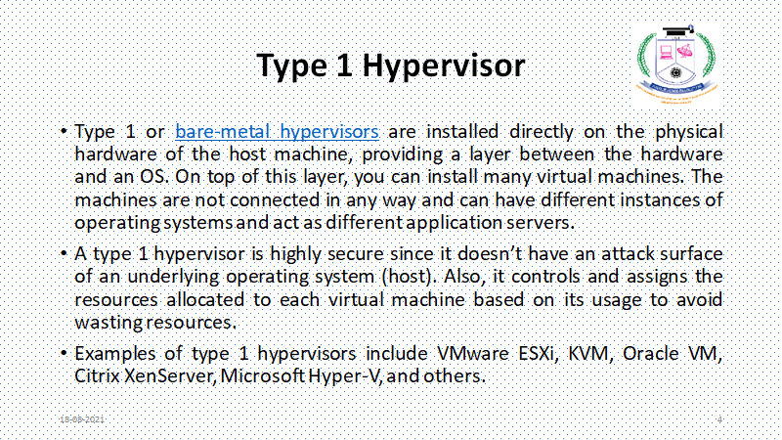

Slide 30
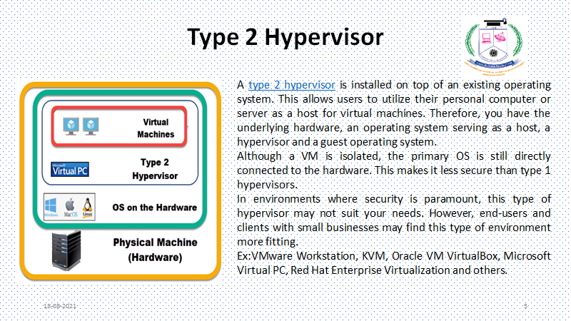

Slide 31
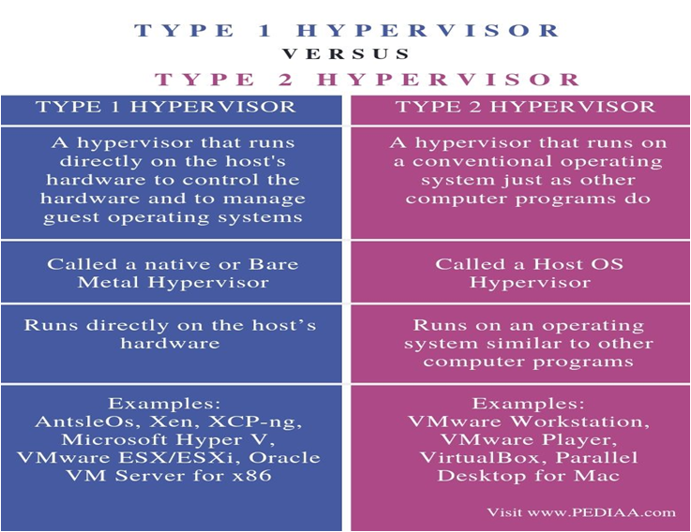

Slide 32
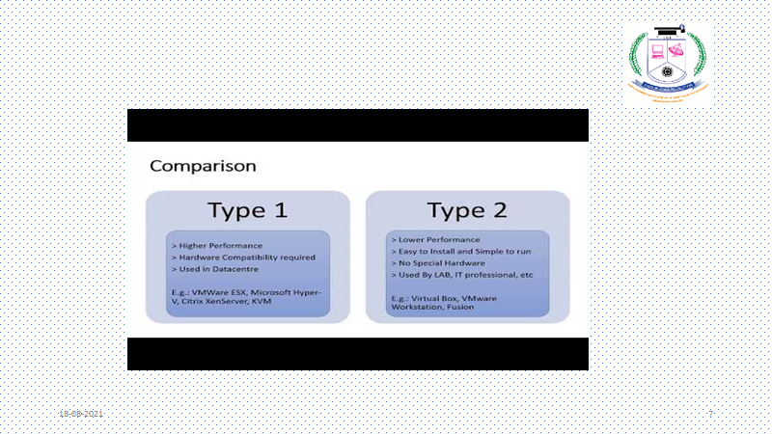

Slide 33
Types of Virtualization in Cloud Computing
Here are six methodologies to look at when talking about virtualization techniques in cloud computing:
Network Virtualization
Storage Virtualizing
Server Virtualization - Machine Virtualization
Data Virtualization
Desktop Virtualizing
Application Virtualization
System-level or Operating Virtualization

Slide 34
Hardware Virtualization:
When the virtual machine software or virtual machine manager (VMM) is directly installed on the hardware system is known as hardware virtualization.
The main job of hypervisor is to control and monitoring the processor, memory and other hardware resources.
After virtualization of hardware system we can install different operating system on it and run different applications on those OS.
Usage:
Hardware virtualization is mainly done for the server platforms, because controlling virtual machines is much easier than controlling a physical server.

Slide 35
Virtualization in Cloud Computing
Virtualization is the "creation of a virtual (rather than actual) version of something, such as a server, a desktop, a storage device, an operating system or network resources"..
In other words, Virtualization is a technique, which allows to share a single physical instance of a resource or an application among multiple customers and organizations.

Slide 36
Desktop virtualization
Desktop virtualization is technology that lets users simulate a workstation load to access a desktop from a connected device remotely or locally.
This separates the desktop environment and its applications from the physical client device used to access it.
Desktop virtualization can be achieved in a variety of ways, but the most important two types of desktop virtualization are based on whether the operating system instance is local or remote.

Slide 37
Local Desktop Virtualization
Local desktop virtualization means the operating system runs on a client device using hardware virtualization, and all processing and workloads occur on local hardware.
This type of desktop virtualization works well when users do not need a continuous network connection and can meet application computing requirements with local system resources.
However, because this requires processing to be done locally you cannot use local desktop virtualization to share VMs or resources across a network to thin clients or mobile devices.

Slide 38
Remote Desktop Virtualization
Remote desktop virtualization is a common use of virtualization that operates in a client/server computing environment.
This allows users to run operating systems and applications from a server inside a data center while all user interactions take place on a client device.
This client device could be a laptop, thin client device, or a smartphone. The result is IT departments have more centralized control over applications and desktops, and can maximize the organization’s investment in IT hardware through remote access to shared computing resources.

Slide 39
The benefits of desktop virtualization?
Resource Management: Desktop virtualization helps IT departments get the most out of their hardware investments by consolidating most of their computing in a data center.
Desktop virtualization then allows organizations to issue lower-cost computers and devices to end users because most of the intensive computing work takes place in the data center.
By minimizing how much computing is needed at the endpoint devices for end users, IT departments can save money by buying less costly machines.

Slide 40
Security
Desktop virtualization software provides IT admins centralized security control over which users can access which data and which applications. If a user’s permissions change because they leave the company, desktop virtualization makes it easy for IT to quickly remove that user’s access to their persistent virtual desktop and all its data—instead of having to manually uninstall everything from that user’s devices.
And because all company data lives inside the data center rather than on each machine, a lost or stolen device does not post the same data risk. If someone steals a laptop using desktop virtualization, there is no company data on the actual machine and hence less risk of a breach.

Slide 41
Network virtualization
In computing, network virtualization is the process of combining hardware and software network resources and network functionality into a single, software-based administrative entity, a virtual network.
External network virtualization combines or subdivides one or more local area networks (LANs) into virtual networks to improve a large network's or data center's efficiency.

Slide 42
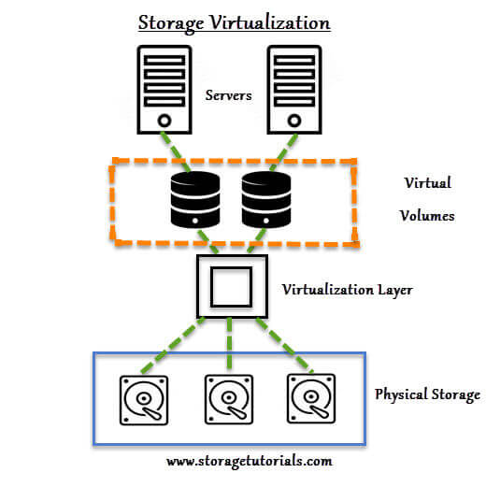
Storage Virtualization

Slide 43
Storage Virtualization
. There are 2 servers with the virtual volumes.
These virtual volumes may be mapped to different applications.
Between the actual storage and the virtual volume there is virtualization layer which helps in redirecting the I/O.
Understand that the physical storage or hard disks are combined or grouped together and then with the help of virtualization software this physical disks are divided into small blocks of data as per the requirements,
which is presented to remote servers as a virtual disk. These virtual blocks of data look as the physical disk to the server.

Slide 44
Benefits of Storage Virtualization
It is highly scalable.
It allows easy addition and deletion of storage without affecting any application.
Easy data migration.
Easy storage management.

Slide 45
Server virtualization
Server virtualization is the process of creating multiple server instances from one physical server. Each server instance represents an isolated virtual environment. Within each virtual environment, you can run a separate operating system.
A virtualization software allowed you to “break up” your physical server into multiple virtual ones. By doing so, you can utilize your physical resources to the fullest, without investing in more hardware.

Slide 46
Types of Server Virtualization
There are three (3) approaches to server virtualization based on the isolation they provide:
Full virtualization or virtual machine model
Paravirtual machine model
Virtualization at the OS level

Slide 47
Full virtualization or virtual machine model
In a full virtual machine model, the hypervisor completely isolates guest machines.
It shares the hardware of the host machine but runs as if being on a completely autonomous computer, unaware of the hypervisor and its role.
These VMs see themselves as self-reliant and efficient. Therefore you do not need to adapt or specially modify their instances of operating systems.

Slide 48
Paravirtual Machine
When you need multiple virtual machines and have flexible resource sharing, a fully virtualized environment may not be necessary. In this case, a para virtualized environment may better suit the situation.
Para-virtualization involves the entire network working together as a cohesive unit. Since each operating system on the virtual servers is aware of one another in para-virtualization, the hypervisor does not need to use as much processing power to manage the operating systems.

Slide 49
Operating System Layer
Virtualization at the OS level is a feature of an operating system which has a kernel that allows the existence of multiple user-space instances. We call this type of virtualization containerization and these user-space instances containers .
Programs can run inside the container but are restricted only to the content of the container and devices assigned to that container. Unlike the primary OS, these user-space instances believe they have all available resources but are limited to the resources allocated to the container.
As this level of virtualization uses the same OS and kernel as the host, it can only differ from its host by the version of OS. Therefore it is limited as it can’t have a different OS than its host.

Slide 50
OS Virtualization
As in cloud technology, virtualization plays an important role to make things easy and efficiently done, virtualization also need to be done at the OS level also.
More commonly called OS-level virtualization. A type of server virtualization technology which works at the OS layer.
The physical server and single instance of the operating system is virtualized into multiple isolated partitions, where each partition replicates a real server.
With the technique of virtualized OS, nothing is required to be pre-installed or permanently loaded on the local storage device.

Slide 51
OS-level virtualization
Here the kernel of an OS allows more than one isolated user-space instances to exist. Such instances are called containers/software containers or virtualization engines.
In other words, OS kernel will run a single operating system & provide that operating system's functionality to replicate on each of the isolated partitions.

Slide 52
Uses of OS Virtualization
Used for virtual hosting environment.
Used for securely allocation of finite hardware resources among a large number of distrusting users.
To improvised security by separating several applications to several containers.
These forms of virtualization don't require hardware to work efficiently.

Slide 53
How to install Linux on Windows With a VMware Virtual Machine

Slide 54
Installation of VMware Workstation Player
Now head over to official VMware site, download the VMware Workstation Player and install the application with the help of installation wizard. After the installation, open up the player which should look something like

Slide 55
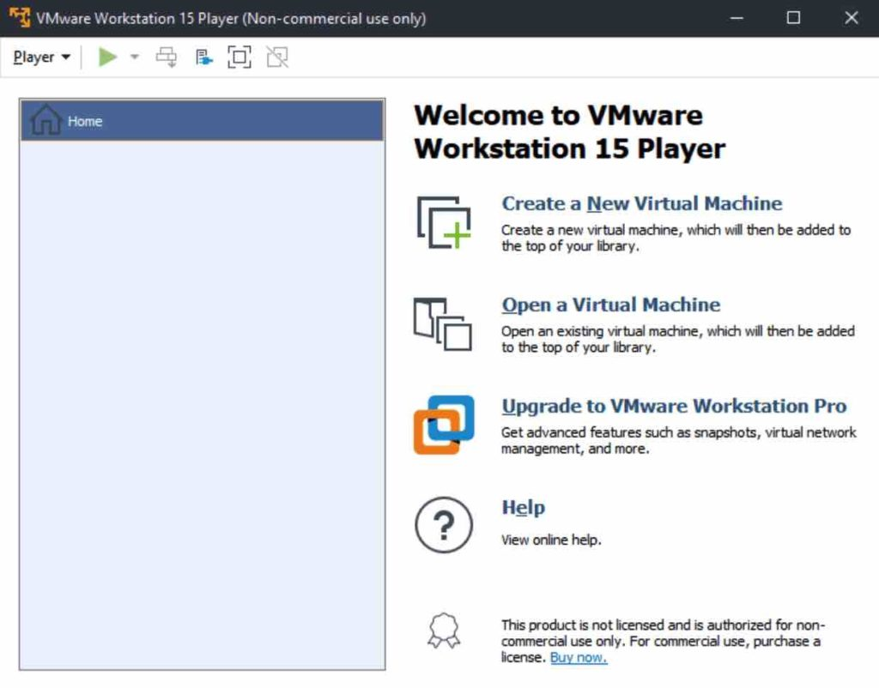

Slide 56
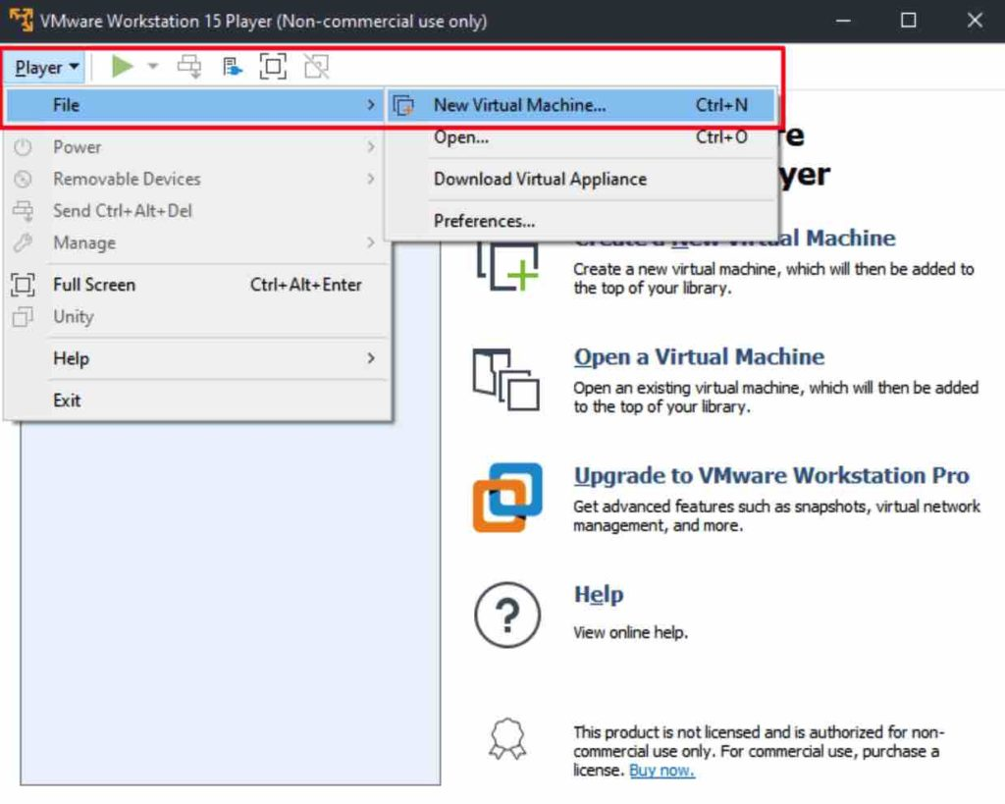
Setting up VMware Workstation Player for Ubuntu

Slide 57
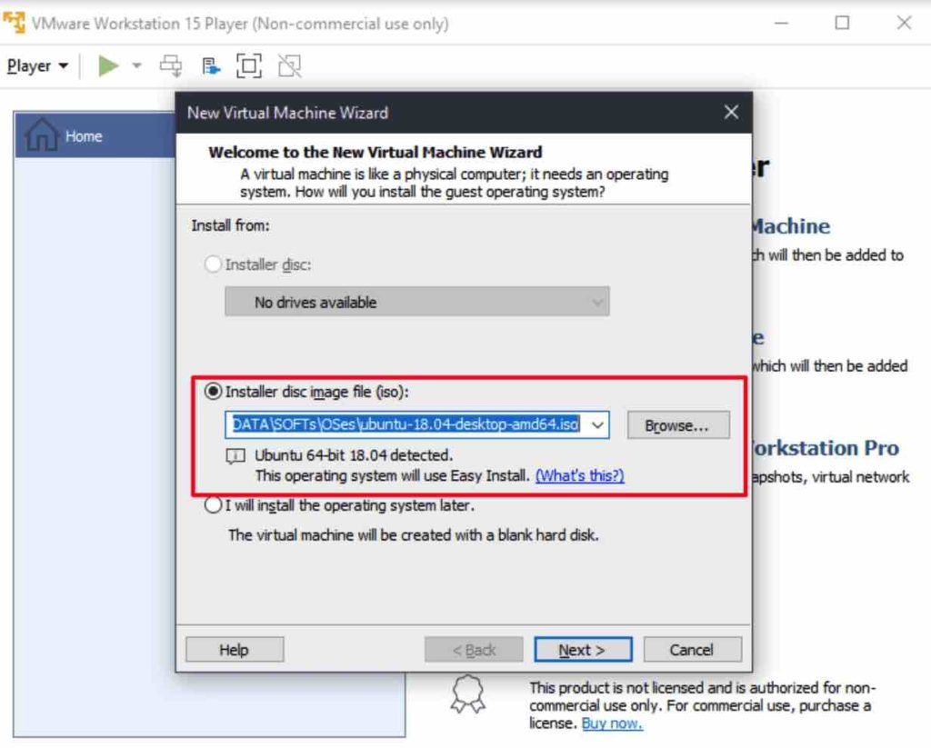

Slide 58
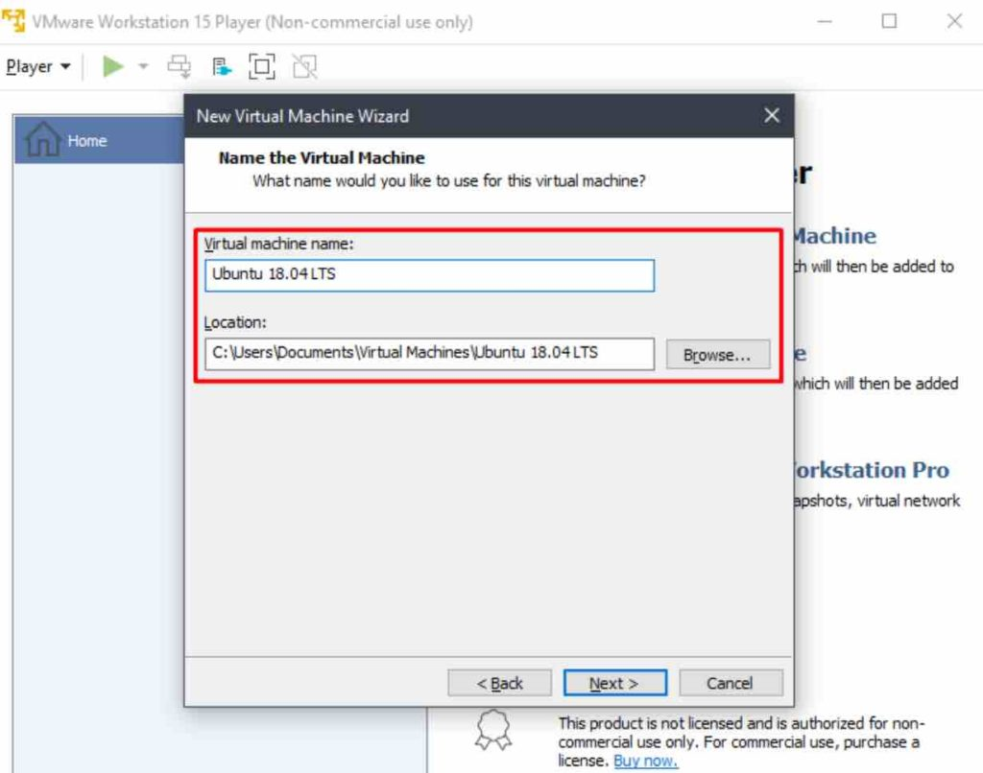

Slide 59
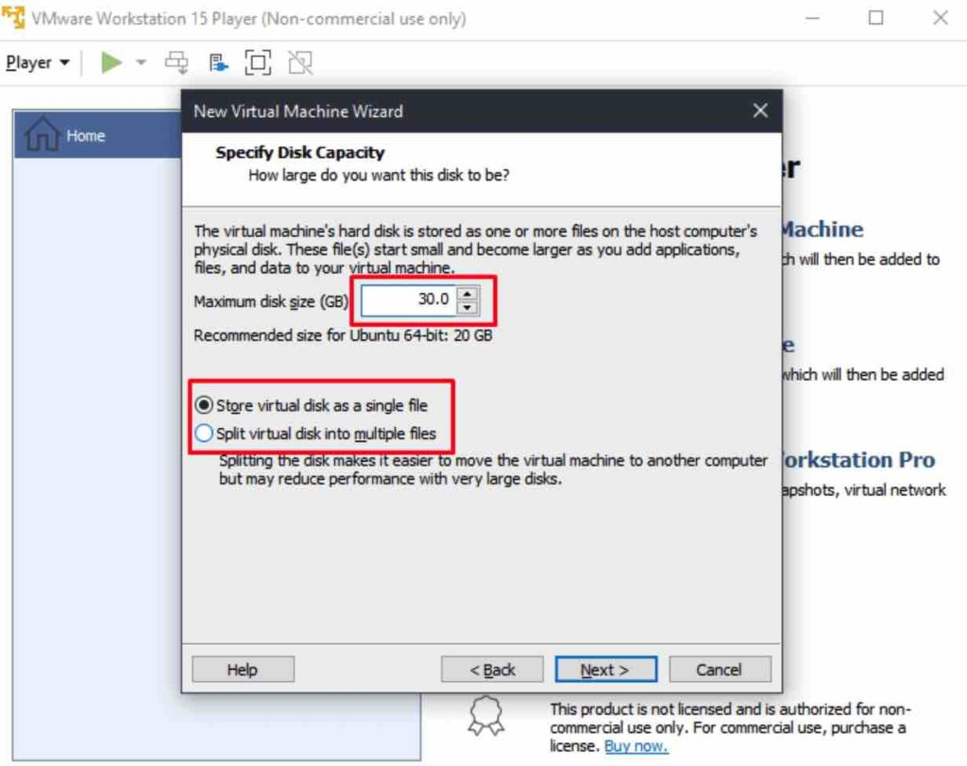

Slide 60
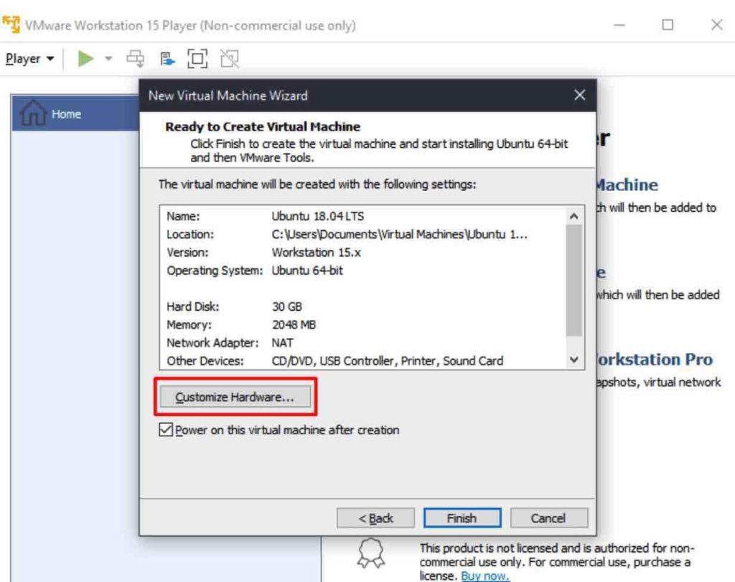

Slide 61
Advantages of OS virtualization
OS virtualization usually imposes little or no overhead.
OS Virtualization is capable of live migration
It can also use dynamic load balancing of containers between nodes and a cluster.
The file level copy-on-write (CoW) mechanism is possible on OS virtualization which makes easier to back up files, more space-efficient and simpler to cache than the block-level copy-on-write schemes.

